Slide 1
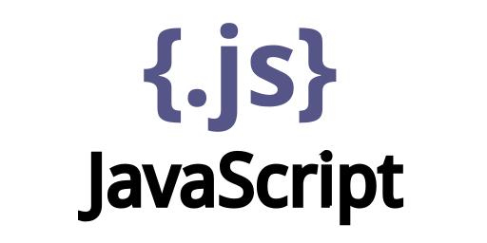
Open source Technologies Lab

Slide 2
Topics
What is JavaScript?
JavaScript Variables
JavaScript Array Methods
JavaScript Loops
Conditional Statements
JavaScript Define & Call Functions
JavaScript DOM Tutorial
Javascript Examples

Slide 3
What is JavaScript?
JavaScript is a very powerful client-side scripting language. JavaScript is used mainly for enhancing the interaction of a user with the webpage. In other words, you can make your webpage more lively and interactive, with the help of JavaScript. JavaScript is also being used widely in game development and Mobile application development.

Slide 4
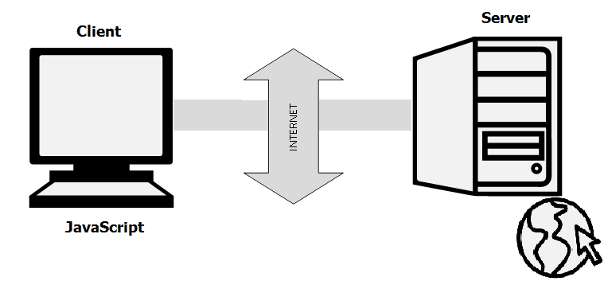
New Features
JavaScript is a client-side scripting language developed by Brendan Eich.
JavaScript can be run on any operating systems and almost all web browsers.
You need a text editor to write JavaScript code and a browser to display your web page.

Slide 5
How to Run JavaScript?
Being a scripting language, JavaScript cannot run on its own. In fact, the browser is responsible for running JavaScript code. When a user requests an HTML page with JavaScript in it, the script is sent to the browser and it is up to the browser to execute it. The main advantage of JavaScript is that all modern web browsers support JavaScript. So, you do not have to worry about whether your site visitor uses Internet Explorer, Google Chrome, Firefox or any other browser. JavaScript will be supported.
Also, JavaScript runs on any operating system including Windows, Linux or Mac.

Slide 6
A Simple JavaScript Program
You should place all your JavaScript code within <script> tags (<script> and </script>) if you are keeping your JavaScript code within the HTML document itself.
This helps your browser distinguish your JavaScript code from the rest of the code. As there are other client-side scripting languages.
It is highly recommended that you specify the scripting language you use.
You have to use the type attribute within the <script> tag and set its value to text/javascript
<script type="text/javascript">

Slide 7
Hello World Example
<html>
<head>
<title>My First JavaScript code!!!</title>
<script type="text/javascript">
alert("Hello World!");
</script>
</head>
<body>
</body>
</html>
Note: type=”text/javascript” is not necessary in HTML5.

Slide 8
JavaScript Variable Declare, Assign a Value
Variables are used to store values (name = “John”) or expressions (sum = x + y).
Declare Variables in JavaScript
Before using a variable, you first need to declare it. You have to use the keyword var to declare a variable like this:
var name;
Assign a Value to the Variable
var name = "John"; or
var name;
name = "John";

Slide 9
Naming Variables
Though you can name the variables as you like, it is a good programming practice to give descriptive and meaningful names to the variables.
Moreover, variable names should start with a letter and they are case sensitive. Hence the variables studentname and studentName are different because the letter n in a name is different (n and N).

Slide 10
Naming Variables
We will see an example…

Slide 11
JavaScript Array Methods
What is an Array?
An array is an object that can store a collection of items. Arrays become really useful when you need to store large amounts of data of the same type.
Suppose you want to store details of 500 employees.
You can access the items in an array by referring to its indexnumber and the index of the first element of an array is zero.
You can create an array in JavaScript as
var students = ["John", "Ann", "Kevin"];
Notes:
If you are using variables, you will have to create 500 variables whereas you can do the same with a single array.

Slide 12
JavaScript Array Methods
Here, you are initializing your array as and when it is created with values “John”, “Ann” and “Kevin”.The index of “John”, “Ann” and “Kevin” is 0, 1 and 2 respectively. If you want to add more elements to the students array, you can do it like this:
students[3] = "Emma";
students[4] = "Rose";
You can also create an array using Array constructor like this:
var students = new Array("John", "Ann", "Kevin");
or
var students = new Array();
students[0] = "John";
students[1] = "Ann";
students[2] = "Kevin";

Slide 13
JavaScript Array Methods
The Array object has many properties and methods which help developers to handle arrays easily and efficiently. You can get the value of a property by specifying arrayname.property.
length property
If you want to know the number of elements in an array, you can use the length property.
prototype property
If you want to add new properties and methods, you can use the prototype property.

Slide 14
JavaScript Array Methods
You can get output of a method by specifying arrayname.method()
reverse method
You can reverse the order of items in an array using a reverse method.
sort method
You can sort the items in an array using sort method.
pop method
You can remove the last item of an array using a pop method.
shift method
You can remove the first item of an array using shift method.
push method
You can add a value as the last item of the array.

Slide 15
JavaScript Array Methods
We will see an example

Slide 16
JavaScript Loops
There are mainly four types of loops in JavaScript.
for loop
for/in a loop (explore yourself)
while loop
do…while loop

Slide 17
for loop
Syntax:
for(statement1; statement2; statment3)
{
lines of code to be executed
}
The statement1 is executed first even before executing the looping code. So, this statement is normally used to assign values to variables that will be used inside the loop.
The statement2 is the condition to execute the loop.
The statement3 is executed every time after the looping code is executed.

Slide 18
for loop example
<html>
<head>
<script type="text/javascript">
var students = new Array("John", "Ann", "Aaron", "Edwin");
document.write("<b>Using for loops </b><br />");
for (i=0;i<students.length;i++)
{
document.write(students[i] + "<br />");
}
</script>
</head>
<body>
</body>
</html>

Slide 19
while loop
Syntax:
while(condition)
{
lines of code to be executed
}
The “while loop” is executed as long as the specified condition is true.
Inside the while loop, you should include the statement that will end the loop at some point of time. Otherwise, your loop will never end and your browser may crash.

Slide 20
while loop example
<html>
<head>
<script type="text/javascript">
document.write("<b>Using while loops </b><br />");
var i = 0, j = 1, k;
document.write("Fibonacci series less than 40<br />");
while(i<40)
{
document.write(i + "<br />");
k = i+j;
i = j;
j = k;
}
</script>
</head>
<body>
</body>
</html>

Slide 21
do…while loop
Syntax:
do
{
block of code to be executed
} while (condition)
The do…while loop is very similar to while loop.
The only difference is that in do…while loop, the block of code gets executed once even before checking the condition.

Slide 22
do..while loop example
<html>
<head>
<script type="text/javascript">
document.write("<b>Using do...while loops </b><br />");
var i = 2;
document.write("Even numbers less than 20<br />");
do
{
document.write(i + "<br />");
i = i + 2;
}while(i<20)
</script>
</head>
<body>
</body>
</html>

Slide 23
JavaScript Conditional Statements
If statement
If…else statement
If…else If…else statement

Slide 24
if statement
Syntax:
if (condition)
{
lines of code to be executed if condition is true
}
You can use If statement if you want to check only a specific condition.

Slide 25
if statement example
<html>
<head>
<title>IF Statments!!!</title>
<script type="text/javascript">
var age = prompt("Please enter your age");
if(age>=18)
document.write("You are an adult <br />");
if(age<18)
document.write("You are NOT an adult <br />");
</script>
</head>
<body>
</body>
</html>

Slide 26
If…else statement
Syntax:
if (condition)
{
lines of code to be executed if the condition is true
}
else
{
lines of code to be executed if the condition is false
}
You can use If….else statement if you have to check two conditions and execute a different set of codes.

Slide 27
If…else statement example
<html>
<head>
<title>If...Else Statments!!!</title>
<script type="text/javascript">
// Get the current hours
var hours = new Date().getHours();
if(hours<12)
document.write("Good Morning!!!<br />");
else
document.write("Good Afternoon!!!<br />");
</script>
</head> <body> </body> </html>

Slide 28
If…else If…else statement
Syntax:
if (condition1)
{
lines of code to be executed if condition1 is true
}
else if(condition2)
{
lines of code to be executed if condition2 is true
}
else
{
lines of code to be executed if condition1 is false and condition2 is false
}
You can use If….Else If….Else statement if you want to check more than two conditions.
Notes:
Open code

Slide 29
If…else If…else statement example
<html>
<head>
<script type="text/javascript">
var one = prompt("Enter the first number");
var two = prompt("Enter the second number");
one = parseInt(one);
two = parseInt(two);
if (one == two)
document.write(one + " is equal to " + two + ".");
else if (one<two)
document.write(one + " is less than " + two + ".");
else
document.write(one + " is greater than " + two + ".");
</script>
</head>
<body>
</body>
</html>

Slide 30
JavaScript Functions
Functions are very important and useful in any programming language as they make the code reusable A function is a block of code which will be executed only if it is called. If you have a few lines of code that needs to be used several times, you can create a function including the repeating lines of code and then call the function wherever you want.

Slide 31
JavaScript Function
Use the keyword function followed by the name of the function.
After the function name, open and close parentheses.
After parenthesis, open and close curly braces.
Within curly braces, write your lines of code.
function functionname()
{
lines of code to be executed
}

Slide 32
JavaScript Function
<html>
<head>
<title>Functions!!!</title>
<script type="text/javascript">
function myFunction()
{
document.write("This is a simple function.<br />");
}
myFunction();
</script>
</head>
<body>
</body>
</html>

Slide 33
Function with Arguments
Syntax:
function functionname(arg1, arg2)
{
lines of code to be executed
}

Slide 34
Function with Arguments: Example
<html>
<head>
<script type="text/javascript">
var count = 0;
function countVowels(name)
{
for (var i=0;i<name.length;i++)
{
if(name[i] == "a" || name[i] == "e" || name[i] == "i" || name[i] == "o" || name[i] == "u")
count = count + 1;
}
document.write("Hello " + name + "!!! Your name has " + count + " vowels.");
}
var myName = prompt("Please enter your name");
countVowels(myName);
</script>
</head> <body> </body> </html>

Slide 35
JavaScript Return Value
You can also create JS functions that return values. Inside the function, you need to use the keyword return followed by the value to be returned.
Syntax:
function functionname(arg1, arg2)
{
lines of code to be executed
return val1;
}

Slide 36
JavaScript Return Value : Example
<html>
<head>
<script type="text/javascript">
function returnSum(first, second)
{
var sum = first + second;
return sum;
}
var firstNo = 78;
var secondNo = 22;
document.write(firstNo + " + " + secondNo + " = " + returnSum(firstNo,secondNo));
</script>
</head>
<body>
</body>
</html>

Slide 37
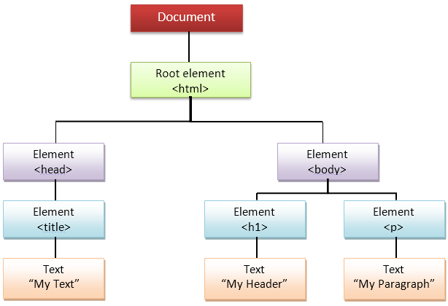
JavaScript DOM
What is DOM in JavaScript?
JavaScript can access all the elements in a webpage making use of Document Object Model (DOM). In fact, the web browser creates a DOM of the webpage when the page is loaded. The DOM model is created as a tree of objects like this:

Slide 38
How to use DOM and Events
Using DOM, JavaScript can perform multiple tasks.
It can create new elements and attributes, change the existing elements and attributes and even remove existing elements and attributes.
JavaScript can also react to existing events and create new events in the page.

Slide 39
getElementById, innerHTML
getElementById
To access elements and attributes whose id is set.
innerHTML
To access the content of an element.
Notes:
DOM methods

Slide 40
getElementById, innerHTML: Example
<html>
<head>
<title>DOM1!!!</title>
</head>
<body>
<h1 id="one">Welcome</h1>
<p>This is the welcome message.</p>
<h2>Technology</h2>
<p>This is the technology section.</p>
<script type="text/javascript">
var text = document.getElementById("one").innerHTML;
alert("The first heading is " + text);
</script>
</body> </html>

Slide 41
getElementsByTagName
getElementsByTagName:
To access elements and attributes using tag name. This method will return an array of all the items with the same tag name.

Slide 42
getElementsByTagName
<html>
<head>
<title>DOM2!!!</title>
</head>
<body>
<h1>Welcome</h1>
<p>This is the welcome message.</p>
<h2>Technology</h2>
<p id="second">This is the technology section.</p>
<script type="text/javascript">
var paragraphs = document.getElementsByTagName("p");
alert("Content in the second paragraph is " + paragraphs[1].innerHTML);
document.getElementById("second").innerHTML = "The orginal message is changed.";
</script>
</body>
</html>

Slide 43
Event handler
createElement
To create new element
removeChild
Remove an element
You can add an event handler to a particular element like this:
document.getElementById(id).onclick=function()
{
lines of code to be executed
}
OR
document.getElementById(id).addEventListener("click", functionname)

Slide 44
Event handler
<html>
<head>
<title>DOM!!!</title>
</head>
<body>
<input type="button" id="btnClick" value="Click Me!!" />
<script type="text/javascript">
document.getElementById("btnClick").addEventListener("click", clicked);
function clicked()
{
alert("You clicked me!!!");
}
</script>
</body> </html>

Slide 45
JavaScript Multiplication Table
Create a simple multiplication table asking the user the number of rows and columns he wants.
let us see the code …

Slide 46
POPUP Message using Event
Display a simple message “Welcome!!!” on your demo webpage and when the user hovers over the message, a popup should be displayed with a message “Welcome to my WebPage!!!”.

Slide 47
JS Forms
Create a sample form program that collects the first name, last name, email, user id, password and confirms password from the user. All the inputs are mandatory and email address entered should be in correct format. Also, the values entered in the password and confirm password textboxes should be the same. After validating using JavaScript, In output display proper error messages in red color just next to the textbox where there is an error.

Slide 48
What to do now …
https://www.w3schools.com/
…
…
…
…
…

Slide 49
Thank
you ☺

